Slide 1
Data Structure Algorithms
Section 10 – AVL Tree

Slide 2
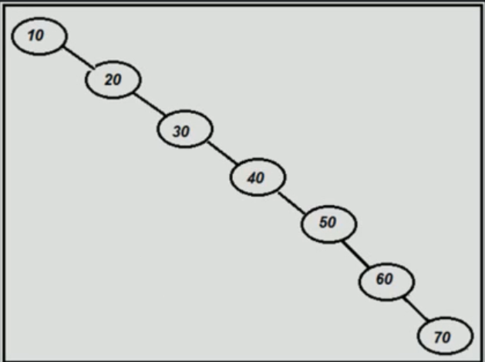
Why AVL Tree?
Question:
Insert 10,20,30,40,50,60,70 in BST
This is kind of tree is disbalance.
To retrieve the number 70 we have to go into 7 nodes
To insert, delete, search has Performance problem.

Slide 3
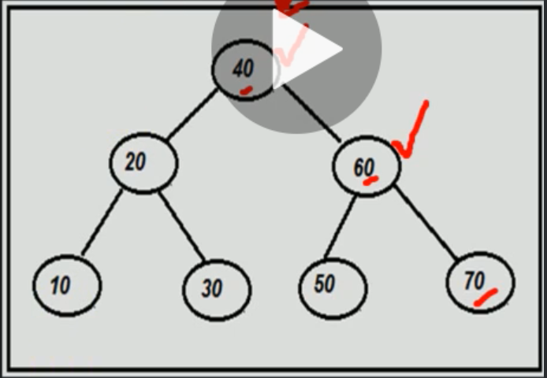
Why AVL Tree?
If we add our nodes in this way, to retrieve the number 70 we have just to go into 3 nodes.
Performance is much better.

Slide 4
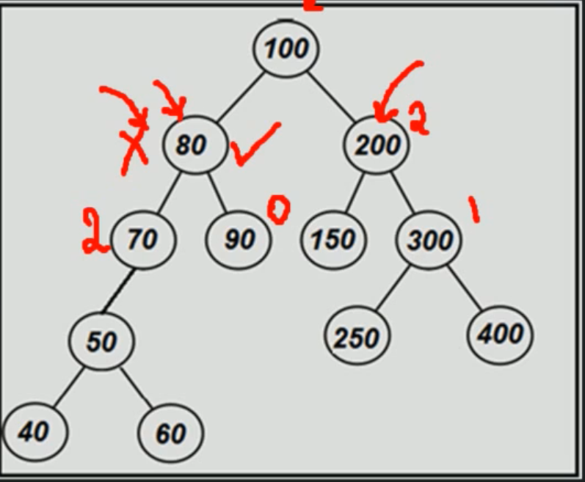
What is AVL Tree?
- An AVL tree is a balanced 'Binary Search Tree' where the height of immediate subtrees of any node differs by at most one (also called balance factor).
If at any time heights differs by more than one, rebalancing is done to restore this property (called rotation)
When you don't have a AVL Tree in your tree you have to apply rotation.

Slide 5
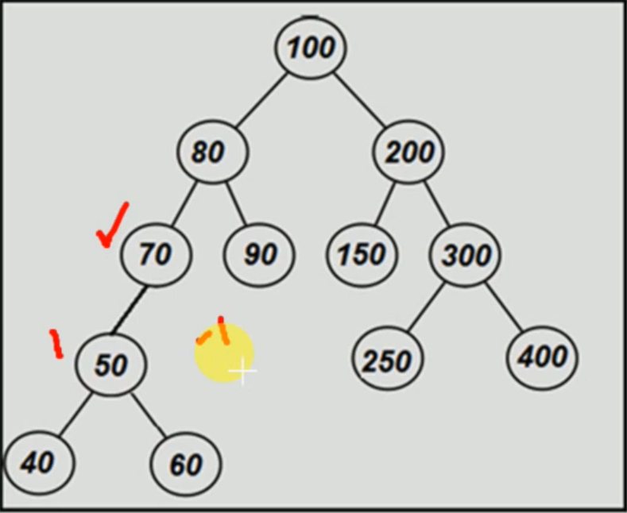
What is AVL Tree?
Note: Binary Search Tree
Left side is smaller the nodes than the right side
- Empty heights always considered-1
The height of subtree is 1
How the right side (node 70) doesn't have child we consider the height -1.
Height -1 will be explained in delete node.

Slide 6

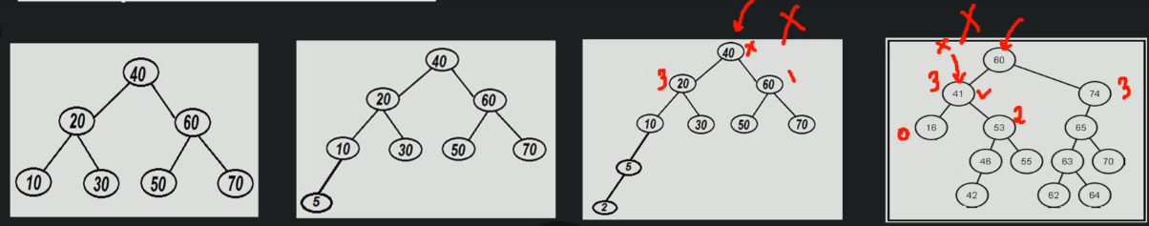
Examples of AVL Tree

Slide 7
Common Operations of AVL Tree
Create a AVL Tree
Search a node
Traverse all nodes
Insert a node
Delete a node
Delete the AVL Tree

Slide 8
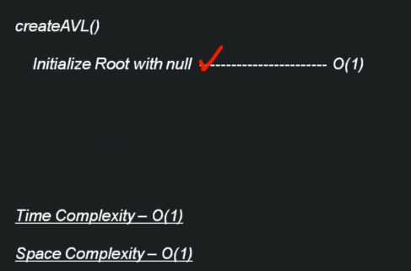
Algorithm – Time & Space Complexity Creation of blank AVL Tree

Slide 9
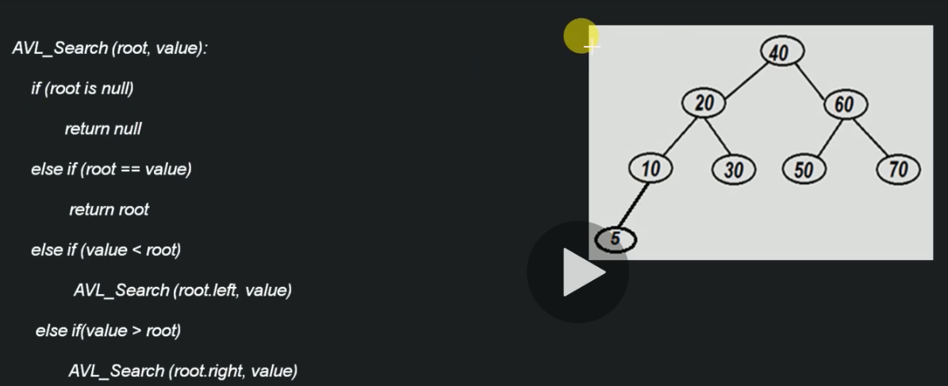
Algorithm – Searching a node in AVL Tree

Slide 10
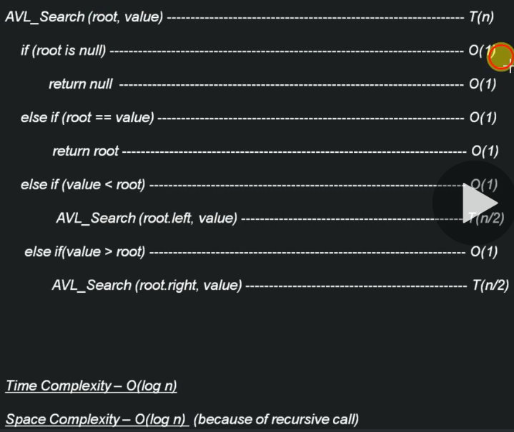
Time & Space Complexity – Searching a node in AVL

Slide 11
Traversing all nodes of AVL Tree:
Depth First Search
PreOrder Traversal
InOrder Traversal
PostOrder Traversal
Breadth First Search
LevelOrder Traversal

Slide 12
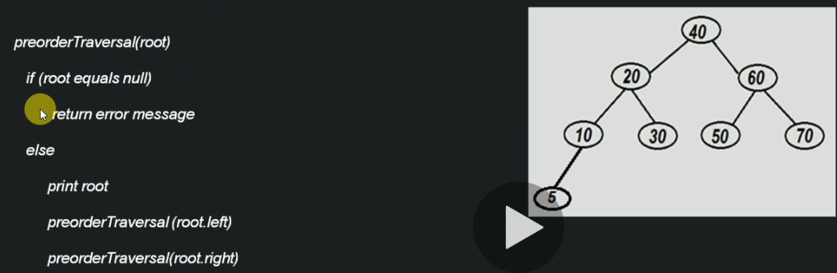
Algorithm – Pre-Order Traversal of AVL

Slide 13
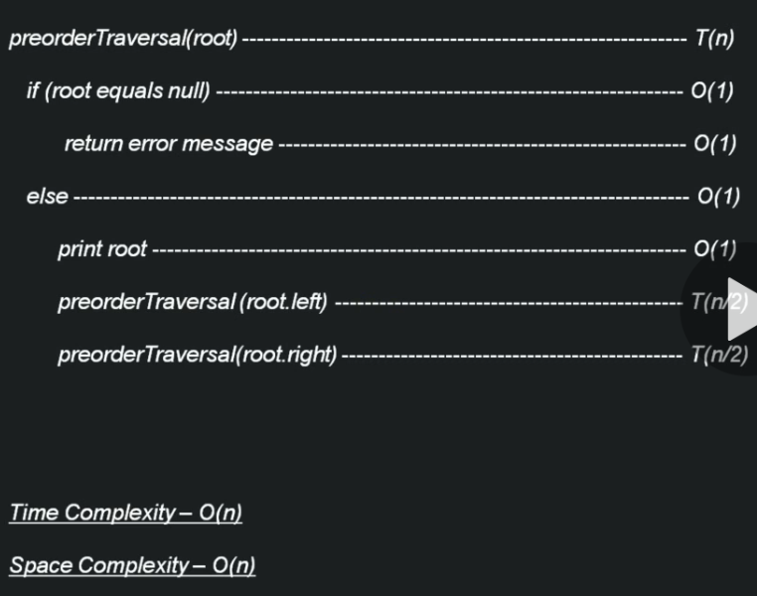
Time & Space Complexity – Pre-Order Traversal of AVL

Slide 14
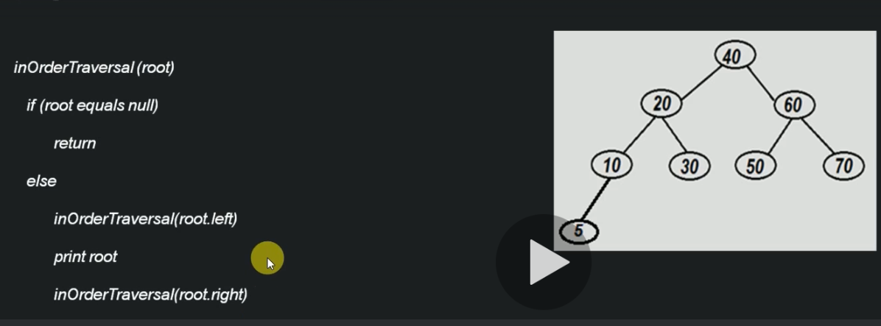
Algorithm – ‘In-Order Traversal’ of AVL

Slide 15
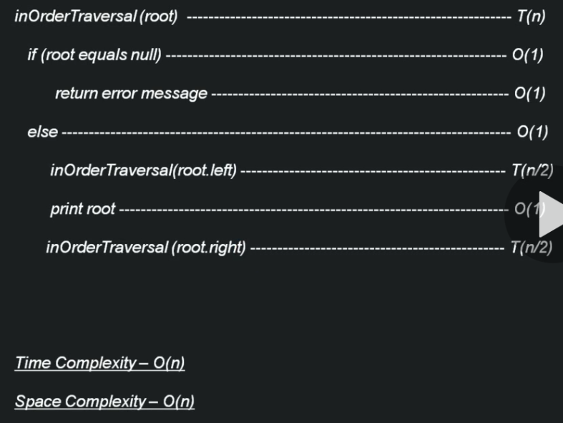
Time & Space Complexity – ‘In-Order Traversal’ of AVL

Slide 16
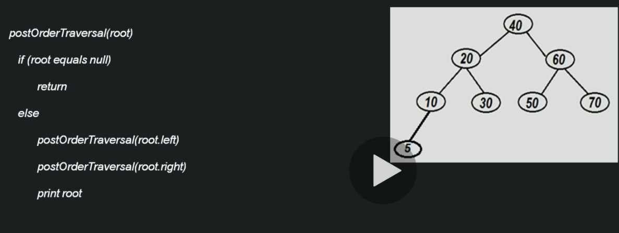
Algorithm – ‘Post-Order Traversal’ of AVL

Slide 17
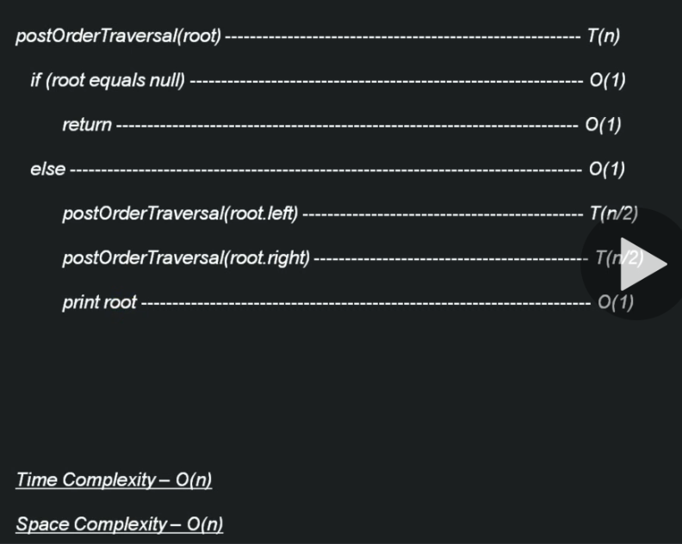
Time & Space Complexity – ‘Post-Order Traversal’ of AVL

Slide 18
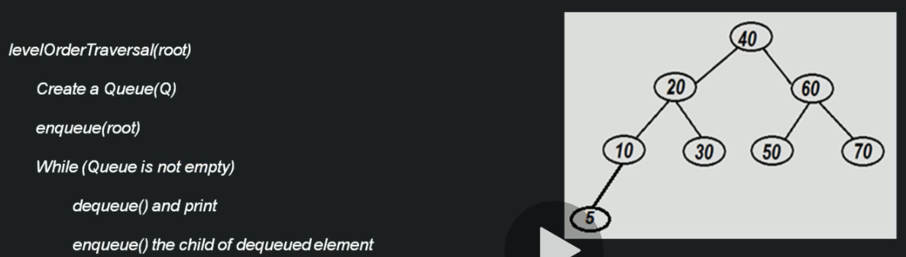
Algorithm – ‘Level Order Traversal’ of AVL

Slide 19
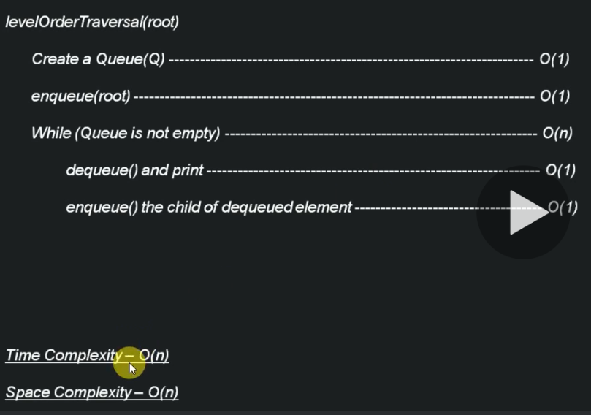
Time & Space Complexity – ‘Level Order Traversal’ of AVL

Slide 20
Algorithm – Creation of blank AVL Tree
CreateAVL()
Initialize Root with null

Slide 21
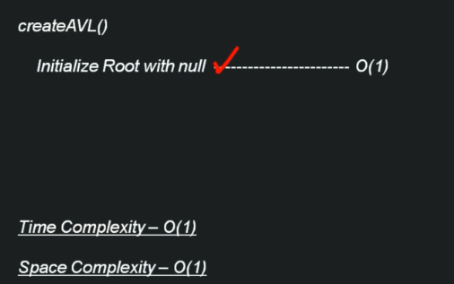
Time & Space Complexity – Creation of blank AVL Tree

Slide 22
Algorithm– Deletion of entire AVL Tree
DeleteAVL()
Root = null

Slide 23
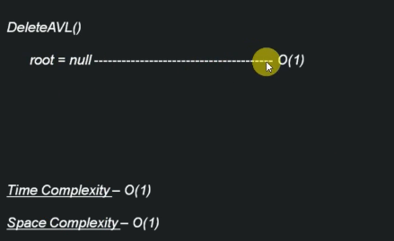
Time & Space Complexity – Deletion of entire AVL Tree

Slide 24
Insertion of Node in AVL Tree
Insertion of a node:
Case#1 - When 'rotation' is not required.
Case#2 - When 'rotation' is required(LL,LR,RR,RL).
Note: Case#1 use the same approach in Binary Search Tree.

Slide 25
Insertion of Node in AVL Tree
'Rotation' Conditions:
Left Left condition (LL)
Left Right condition (LR)
Right Right condition (RR)
Right Left condition (RL)

Slide 26
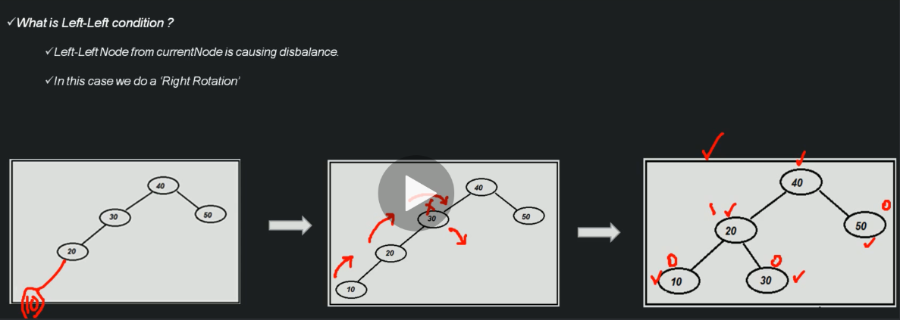
Left-Left Condition

Slide 27
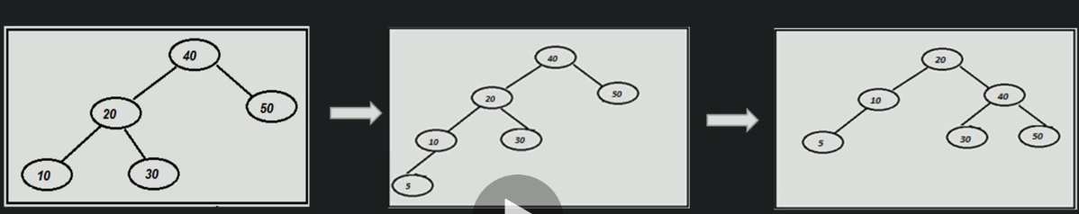
Left-Left Condition (Example#2)

Slide 28
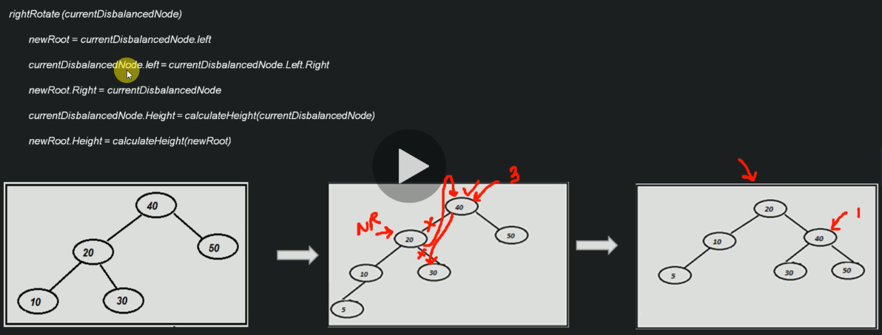
Algorithm: Left-Left Condition

Slide 29
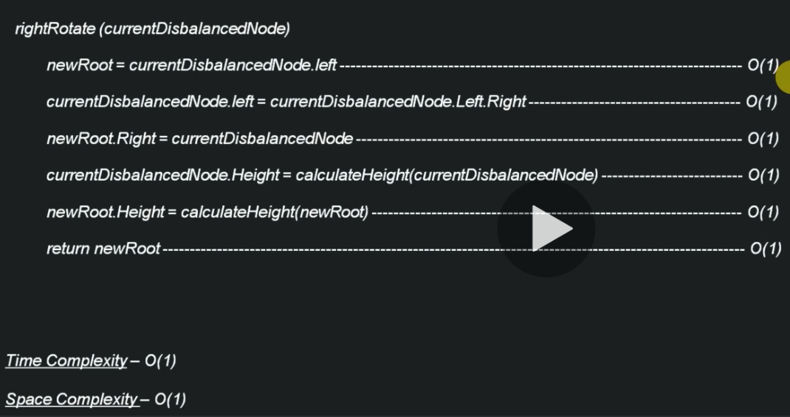
Time & Space Complexity: Left-Left Condition

Slide 30
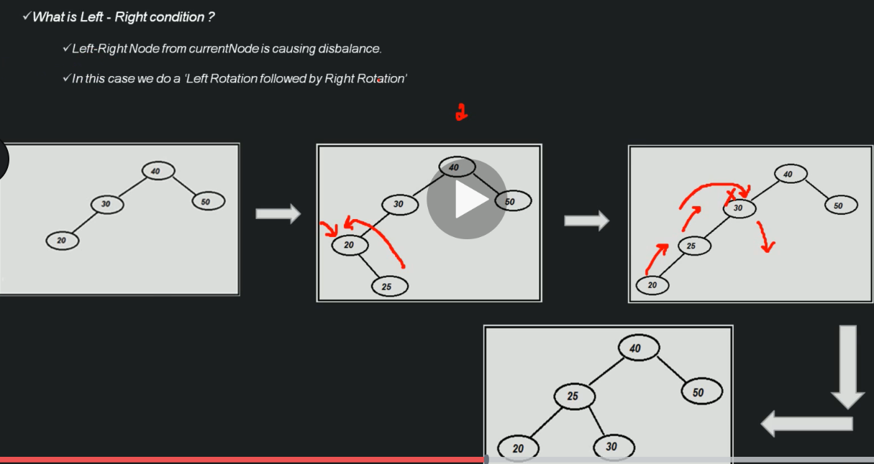
Left-Right Condition

Slide 31
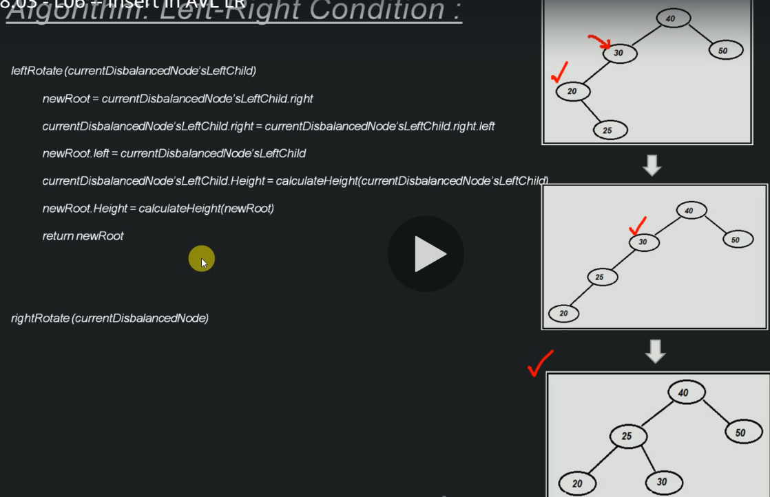
Algorithm – Left-Right Condition

Slide 32
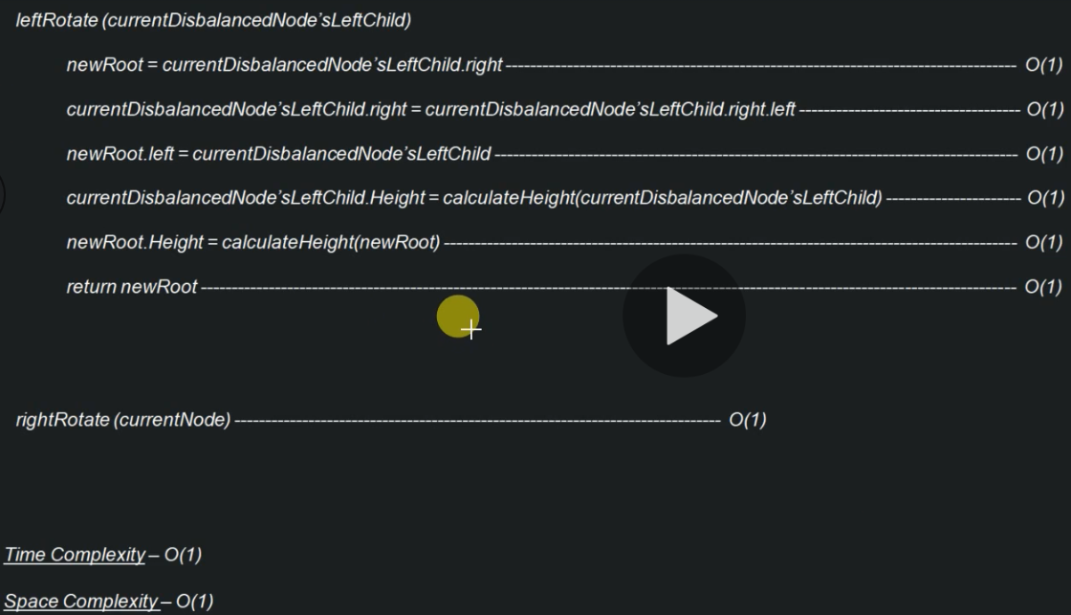
Time & Space Complexity – Left-Right Condition

Slide 33
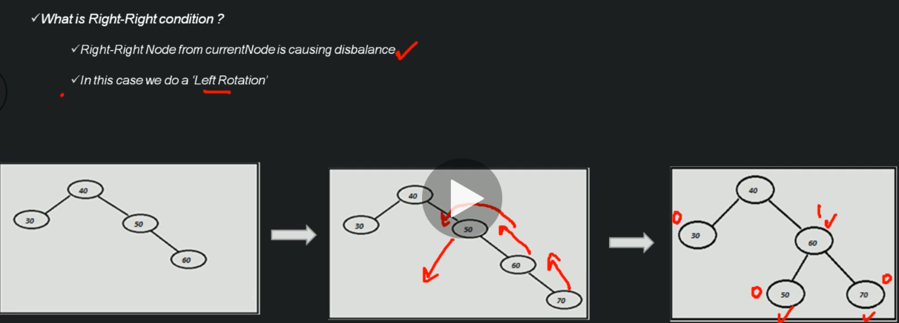
Right-Right Condition

Slide 34
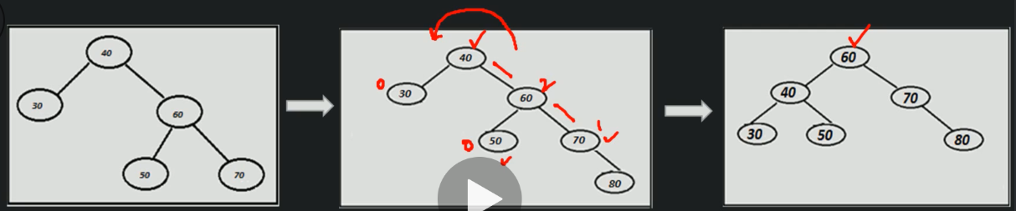
Right-Right Condition (Example#2)

Slide 35
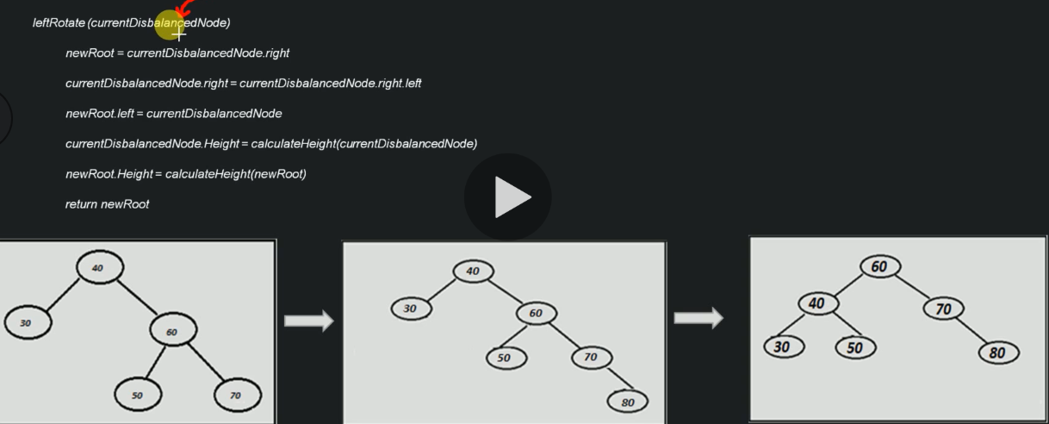
Algorithm - Right-Right Condition

Slide 36
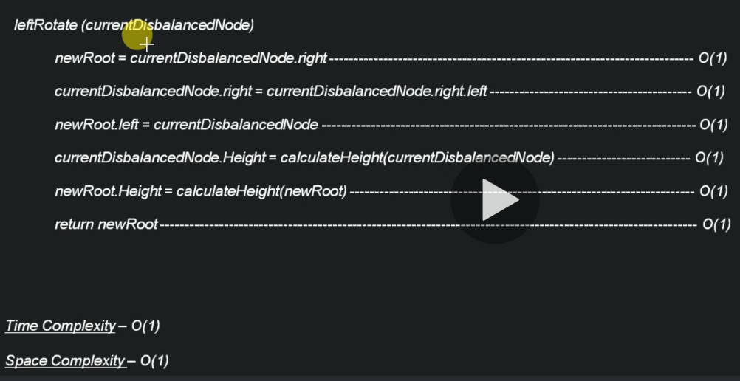
Time & Space Complexity - Right-Right Condition

Slide 37
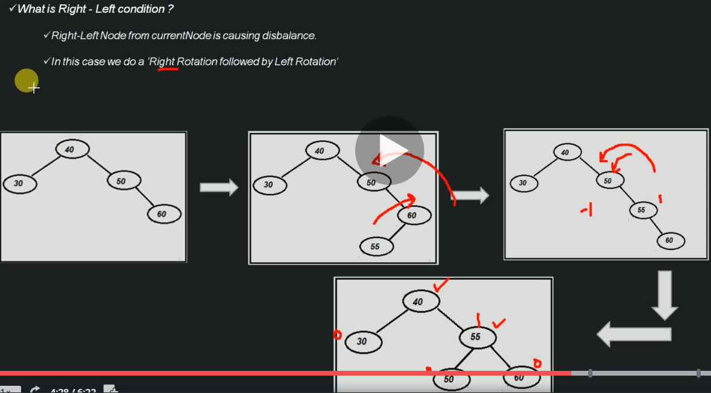
Right – Left Condition

Slide 38
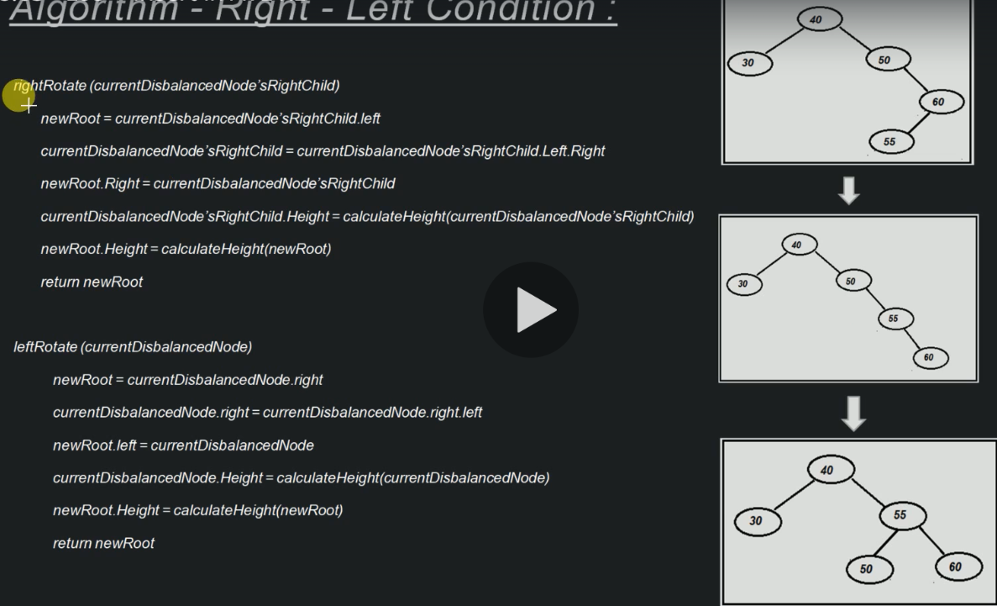
Algorithm - Right – Left Condition

Slide 39
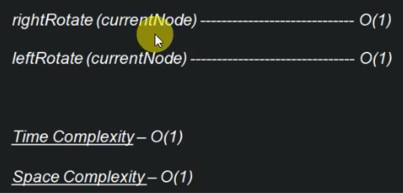
Time & Space Complexity - Right – Left Condition

Slide 40
Time & Space Complexity - Right – Left Condition

Slide 41
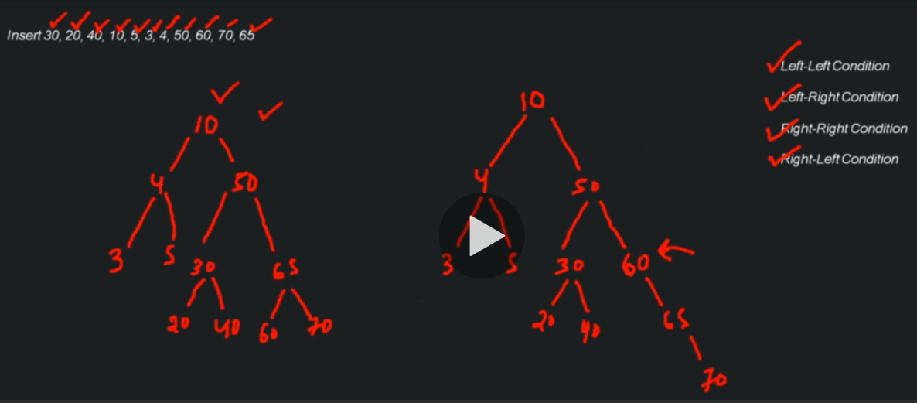
Insertion in AVL Tree (End to End Flow)

Slide 42
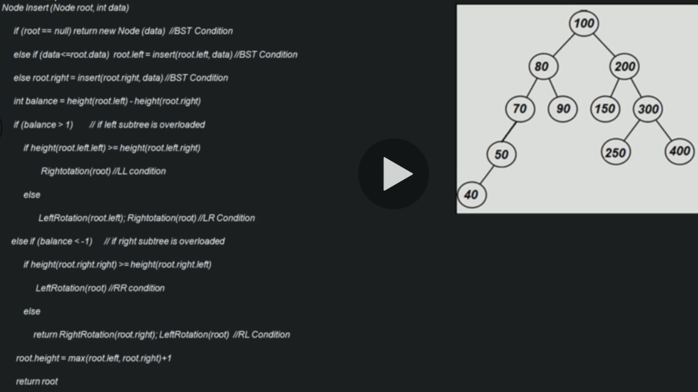
Algorithm - Insertion in AVL Tree

Slide 43
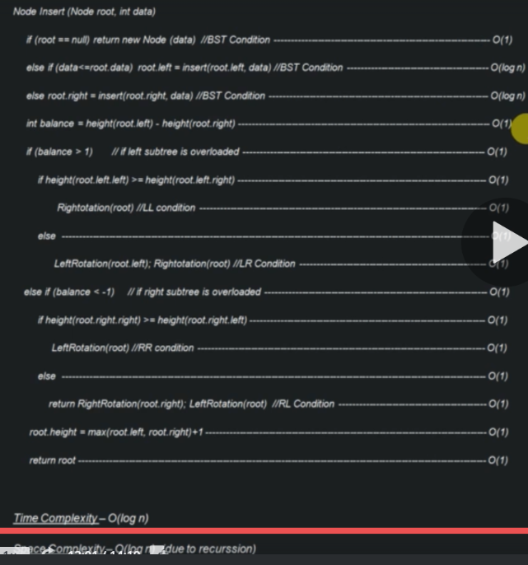
Time & Space Complexity - Insertion in AVL Tree

Slide 44
Deletion of Node from AVL Tree:
Deletion of a Node:
Case#1 - When tree doesn't exists
Case#2 - When 'rotation' is no required (BST Conditions)
Case#3 - When 'rotation' is required (LL, LR, RR, RL)
Case#1 - When tree doesn't exists
We don't need to do anything.

Slide 45
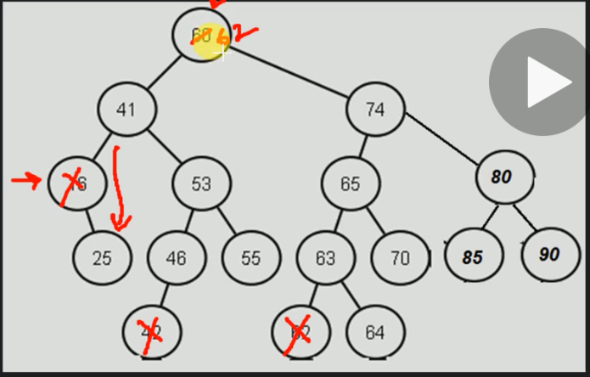
Deletion of Node from AVL Tree - Case#2
When 'rotation' is not required
Node to be deleted is leaf node
Node to be deleted is having 1 child
Node to be deleted has 2 children.
Note: If you want to understand with more details go to Binary Search Tree section.

Slide 46
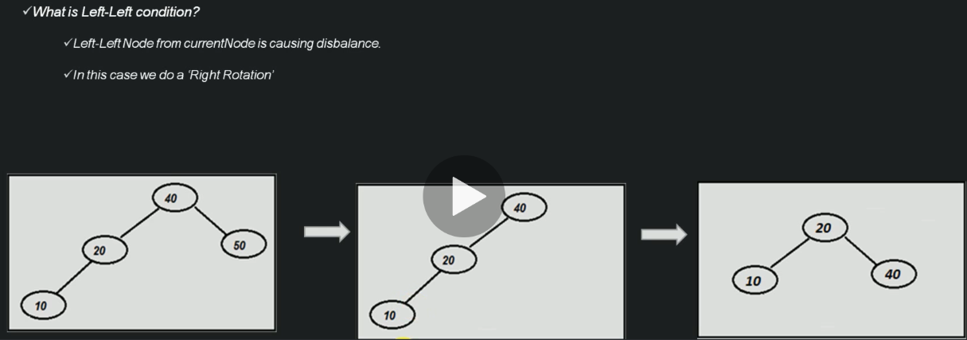
Left-Left Condition

Slide 47
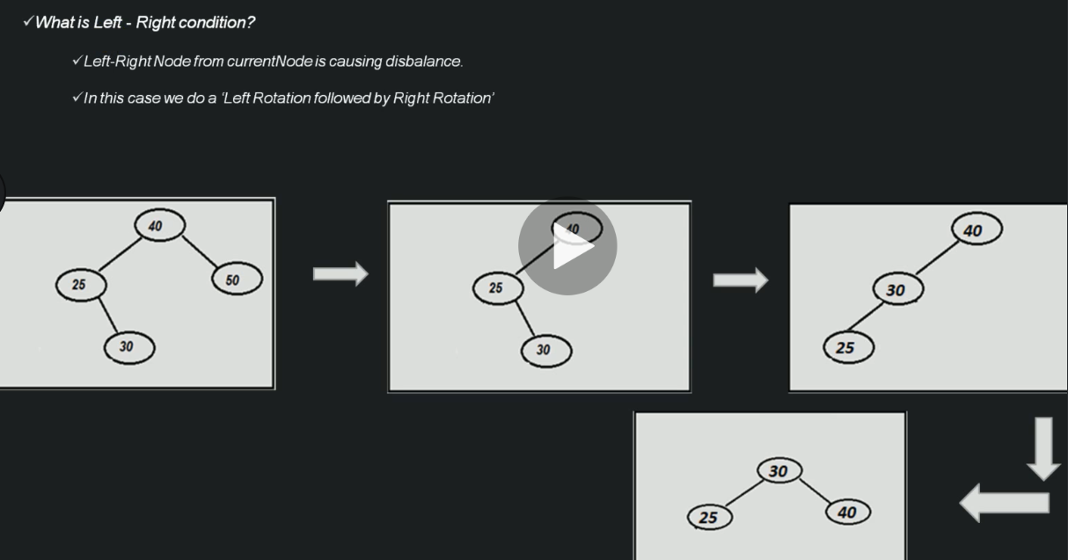
Left-Right Condition

Slide 48
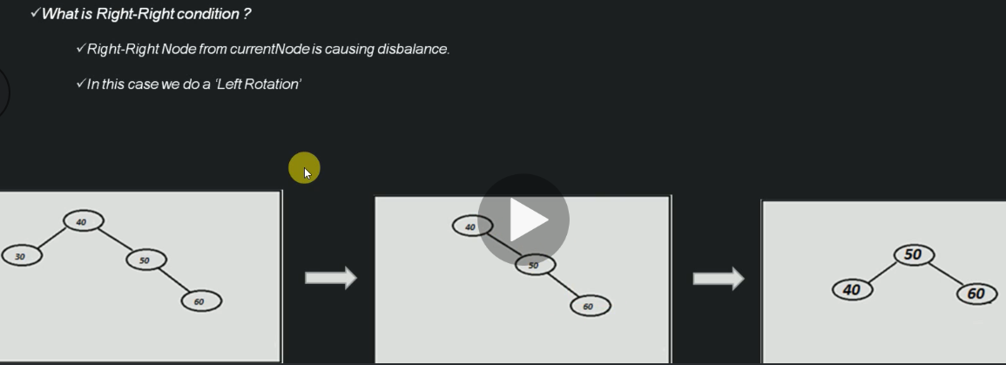
Right-Right Condition

Slide 49
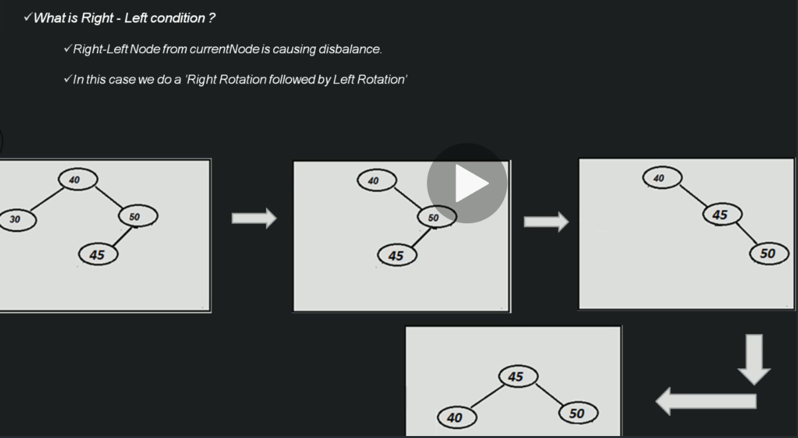
Right-Left Condition

Slide 50
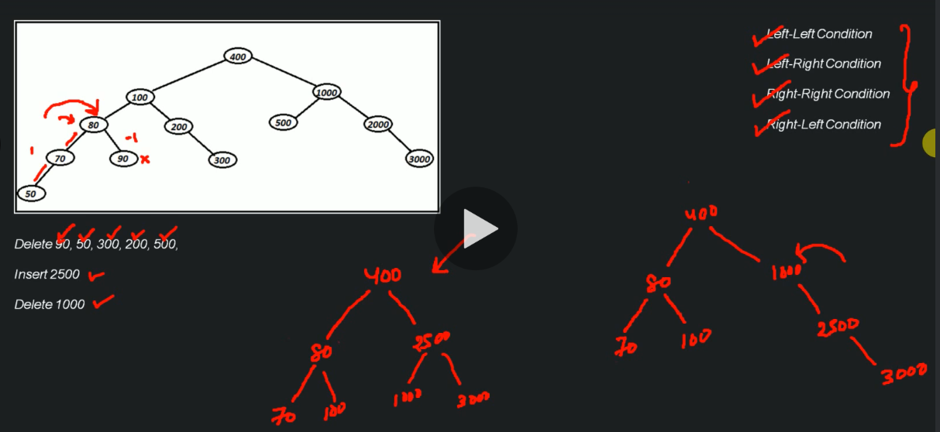
Delete Node from AVL Tree (End to End Example)

Slide 51
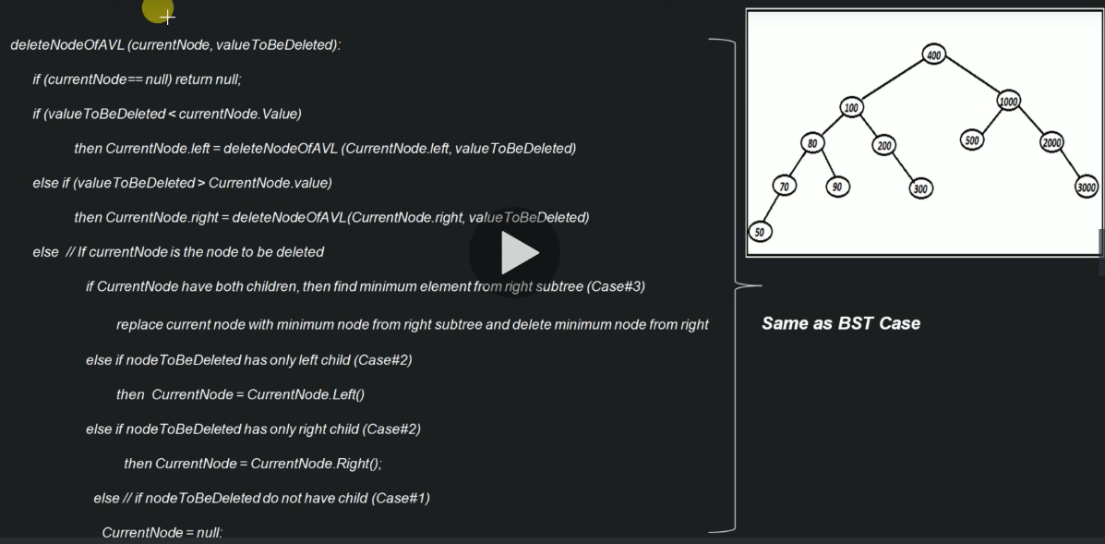
Algorithm - Delete Node from AVL Tree

Slide 52
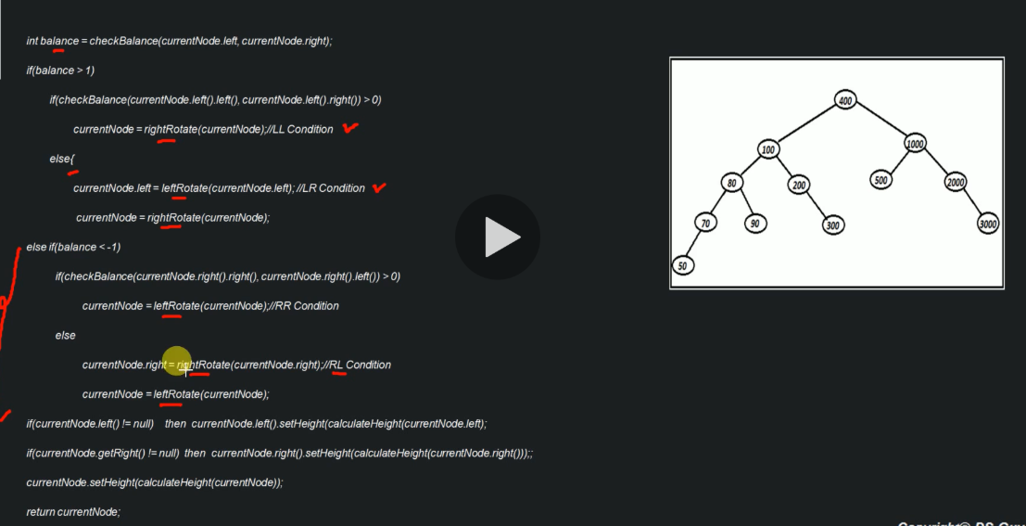
Algorithm - Delete Node from AVL Tree (Continued..)

Slide 53
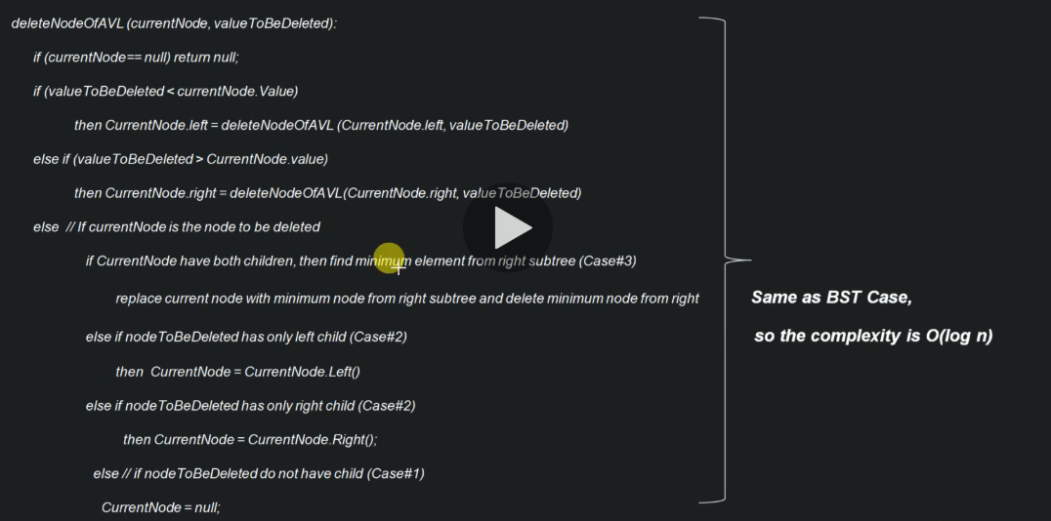
Time & Space Complexity - Delete Node from AVL Tree

Slide 54
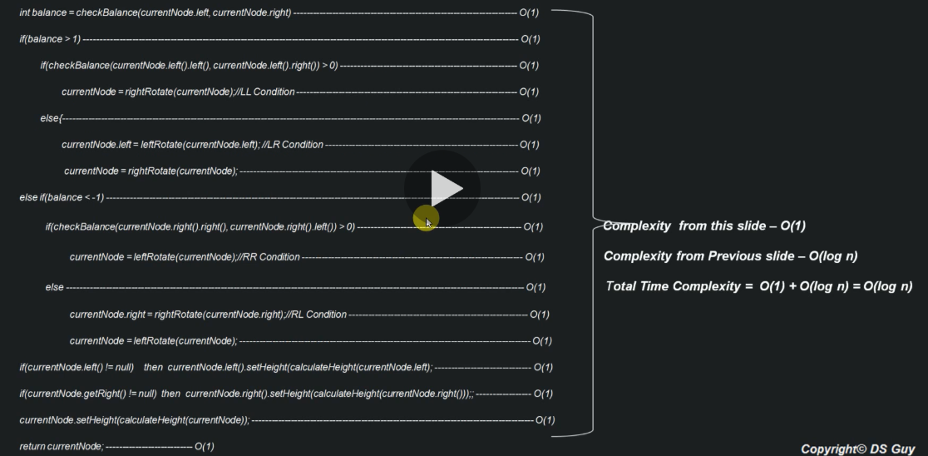
Time & Space Complexity - Delete Node from AVL Tree (Continued…)

Slide 55
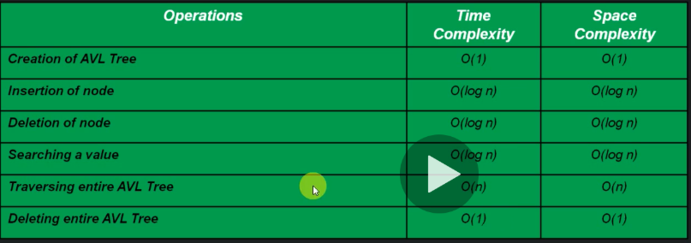
Time & Space Complexity of AVL Tree

Slide 56
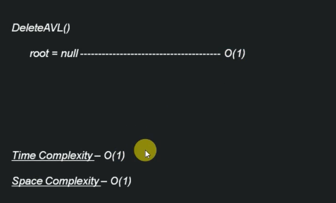
Time & Space Complexity – Deletion of entire AVL Tree

Slide 57
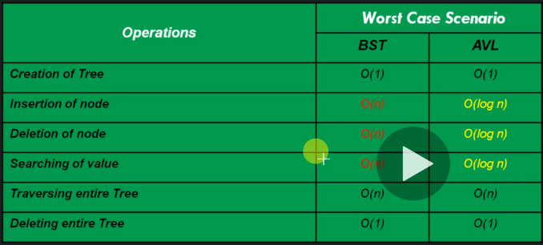
BST vs AVL

